Slide 1

2024 IEEE INTERNATIONAL CONFERENCE ON RECENT INNOVATION IN SMART AND SUSTAINABLE TECHNOLOGY (ICRISST 2024)
Date: 15-16 March, 2024
Customer Segmentation and Retention Strategies For Bank Using ML
HEMANTH KUMAR BEEDHI REDDY
Paper Id. ICRISST20241684

Slide 2
ABSTRACT
Customer churn poses a significant challenge for banks, affecting revenue and customer satisfaction. This study employs machine learning techniques, specifically Naive Bayes, Decision Tree, and AdaBoost classifiers, to predict and minimize churn rates.
Undersampling using the NearMiss algorithm is applied to balance the dataset, and the models are evaluated using essential metrics like recall and ROC-AUC score. Hyperparameter tuning is conducted to optimize model performance. The chosen AdaBoost model demonstrates superior recall on both the training and test datasets, making it the preferred model.
The evaluation extends to the ROC-AUC curve, illustrating the model's trade-off between true positive rate and false positive rate. The final model's predictions are exported, and the results showcase the actual and predicted churn status of customers.

Slide 3
INTRODUCTION
The use of machine learning algorithms can be a powerful tool for predicting customer churn in the bank sector.
These algorithms can analyze large amounts of data and identify patterns and relationships that are not easily apparent to the human eye.
By using machine learning algorithms, companies can make more accurate predictions about which customers are likely to churn and take action to retain them.

Slide 4
PROBLEM STATEMENT
In the highly competitive bank industry, retaining customers is a critical challenge for companies. Customer churn, or the loss of customers to competitors, can have a significant impact on a company's revenue and profitability.
To address this challenge, companies need to be proactive in identifying which customers are most likely to churn, so that they can take action to retain them.
The goal of project is to develop a predictive model that accurately identifies customers who are likely to churn in the telecom sector and banking. The model should take into account a variety of factors, including customer demographics, usage patterns, and satisfaction levels, in order to make accurate predictions.

Slide 5
RESEARCH OBJECTIVE
To accurately predict which customers are likely to churn, based on past behaviour and customer characteristics.
To develop a predictive model that is robust and scalable, taking into account data quality, customer behaviour complexity, and high-dimensional data.
To improve model interpretability, so that the results of the model can be understood and used by stakeholders to make informed decisions.
To evaluate the performance of the model and compare it to other models, taking into account predictive performance metrics and overall model accuracy.

Slide 6
Model training
Three machine learning algorithms: Naive Bayes, Decision Tree, and AdaBoost.
Naive Bayes Model Training:
Initialization: The Gaussian Naive Bayes classifier is initialized.
Resampling: NearMiss undersampling technique is applied to balance the class distribution in the training data.
Model Training: The Naive Bayes classifier is fitted to the resampled training data.
Prediction: The model is used to make predictions on the test data.
Evaluation: The recall score, ROC-AUC score, and confusion matrix are calculated to evaluate the model's performance.
Cross-Validation (Before Tuning): Cross-validation is performed to assess the model's performance before hyperparameter tuning.

Slide 7
Decision Tree Model Training:
Initialization: The Decision Tree classifier is initialized.
Resampling: NearMiss undersampling technique is applied to balance the class distribution in the training data.
Model Training: The Decision Tree classifier is fitted to the resampled training data.
Prediction: The model is used to make predictions on the test data.
Evaluation: The recall score, ROC-AUC score, and confusion matrix are calculated to evaluate the model's performance.
Hyperparameter Tuning: GridSearchCV is used to search for the best hyperparameters for the Decision Tree classifier.
Cross-Validation (Before Tuning): Cross-validation is performed to assess the model's performance before hyperparameter tuning.
Cross-Validation (After Tuning): Cross-validation is performed to assess the model's performance after hyperparameter tuning

Slide 8
AdaBoost Model Training:
Initialization: The AdaBoost classifier is initialized.
Resampling: NearMiss undersampling technique is applied to balance the class distribution in the training data.
Model Training: The AdaBoost classifier is fitted to the resampled training data.
Prediction: The model is used to make predictions on the test data.
Evaluation: The recall score, ROC-AUC score, and confusion matrix are calculated to evaluate the model's performance.
Hyperparameter Tuning: GridSearchCV is used to search for the best hyperparameters for the AdaBoost classifier.
Cross-Validation (Before Tuning): Cross-validation is performed to assess the model's performance before hyperparameter tuning.
Cross-Validation (After Tuning): Cross-validation is performed to assess the model's performance after hyperparameter tuning.

Slide 9
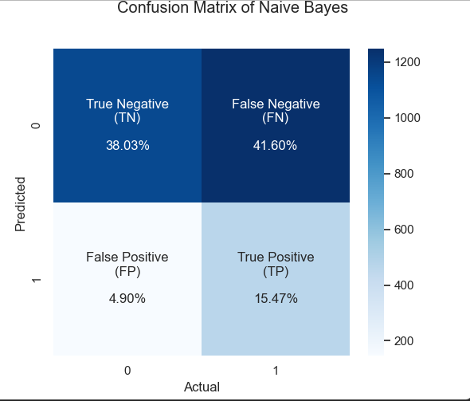

Slide 10
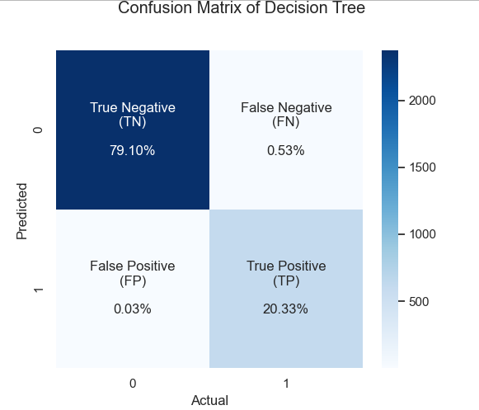

Slide 11
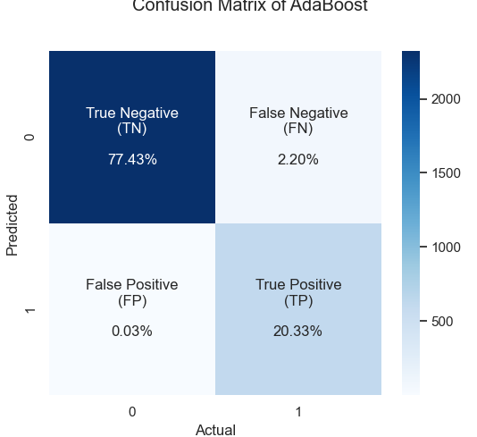

Slide 12
Results
Quick and interpretable insights with Naive Bayes, ideal for initial analysis.
Decision Trees handle complex relationships and provide interpretable decision rules.
AdaBoost ensures high accuracy in predicting churn and enables targeted interventions.
Combined approach: Naive Bayes for quick insights, Decision Trees for deeper understanding, and AdaBoost for precise interventions.

Slide 14
Conclusion
Preprocessing involves handling challenges like duplicate values, missing data, and categorical features through feature engineering and encoding.
Imbalanced datasets addressed using NearMiss algorithm for under sampling to improve generalization.
Evaluation metrics such as precision, recall, and ROC-AUC score serve as benchmarks for model performance assessment.
Hyperparameter tuning enhances AdaBoost model, demonstrating superior performance in achieving high precision rates on both training and test datasets.

Slide 15
REFERENCES
V. Kavitha, G. H. Kumar, S. Kumar, and M. Harish, “Churn prediction of customer in telecom industry using machine learning algorithms,” International Journal of Engineering Research and Technology, vol. 9, no. 5, pp. 181–184, 2020.
G. Jiao and H. Xu, “Analysis and comparison of forecasting algorithms for telecom customer churn,” Journal of Physics: Conference Series, vol. 1881, no. 3, Article ID 032061, 2021. Q. Zhu, X. Yu, Y. Zhao, and D. Li, “Customer churn prediction based on LASSO and random forest models,” IOP conference series materials science and engineering, vol. 631, no. 5, Article ID 052008, 2019.
K. G. Li and B. P. Marikannan, “Hyperparameters tuning and model comparison for telecommunication customer churn predictive models,” in Proceedings of the Paper presented at the 3rd Global Conference on Computing and Media Technology, Kuala Lumpur, Malaysia, July 2020.
T. Wang, X. Wang, R. Ma, X. Li, and J. Ruan, “Random forest-bayesian optimization for product quality prediction with large-scale dimensions in process industrial cyber–physical systems,” IEEE Internet of Things Journal, vol. 7, no. 9, pp. 8641–8653, 2020.
L. Yang and A. Shami, “On hyperparameter optimization of machine learning algorithms: theory and practice,” Neurocomputing, vol. 415, pp. 295–316, 2020.

Slide 16
Contd….
N. Hoque, D. K. Bhattacharyya, and J. K. Kalita, “A mutual information-based feature selection method,” Expert Systems with Applications, vol. 41, no. 14, pp. 6371–6385, 2014.
I. AlShourbaji, N. Helian, Y. Sun, and M. Alhameed, “Anovel HEOMGA approach for class imbalance problem in the application of customer churn prediction,” SN Computer Science, vol. 2, no. 6, pp. 1–12, 2021.
H. Jain, A. Khunteta, and S. Srivastava, “Churn prediction in telecommunication using logistic regression and logit boost,” Procedia Computer Science, vol. 167, pp. 101–112, 2020.
S. Wang, L. L. Minku, and X. Yao, “Online class imbalance learning and its applications in fault detection,” International Journal of Computational Intelligence and Applications, vol. 12, no. 4, Article ID 1340001, 2013.
F. Zhao and Z. Yao, “Predicting the voluntary donation to online content creators,” Industrial Management & Data Systems, vol. 120, no. 10, pp. 1941–1957, 2020.
A. Onan, S. Korukoğlu, and H. Bulut, “Ensemble of keyword extraction methods and classifiers in text classification,” Expert Systems with Applications, vol. 57, pp. 232–247, 2016.
A. Onan, “An ensemble scheme based on language function analysis and feature engineering for text genre classification,” Journal of Information Science, vol. 44, no. 1, pp. 28–47, 2018.

Slide 17
Any Questions?..

